Slide 1
Label Approval
TOP APPLIED LABELS (Endfold, Patch)
- Label should lay smooth/flat
- No wavy edges
- Label set with 1/16” SN/LS - Backstitch @ start & stop for 3-4 stitches
- Label SPI = 8-10
- Thread
- Needle: DTM to Label
- Bobbin: DTM to shell fabric
- No Monofilament/clear thread
- NO Thread nests or untrimmed threads on exterior garment
INTERIOR IMAGE
EXTERIOR IMAGE
INSERT LABELS (Loop, Miter)
- Label should lay smooth/flat
- No wavy edges
- Label is secured in garment construction
- Thread
- No Monofilament/clear thread
- NO Thread nests or untrimmed threads on exterior garment
Heat Transfer (Heat Seal)
- Label text must be visually straight not slanted on the garment
- Print must not be visible from garment exterior
- Heat transfer process must not leave color shading or permanent mark on garment exterior
- Heat seal label must be tested on each fabrication/wash/color for durability according to Kohl’s Appearance Evaluation Requirements Procedures
TEMPLATE
Notes:
DTM on the thread
If there is an exception Design should specify and call it out at HO and BOM
http://nordstromsupplier.com/npg/PDFs/Technical%20Design/Label%20Placements/Women's/2014/S6C1%20CE-CEA%20Woven%20Label%20and%20Placement%20Manual.pdf
https://www.colonybrands.com/wp-content/uploads/sites/24/2018/04/NF-11-Label-Placement-Guide.pdf
LE updated image - original image is off to the far right side.
https://www.genescopartners.com/jm/documents/product_category_standards/JM_Womens_Hangtag_Label_Placement_Manual.pdf

Slide 2
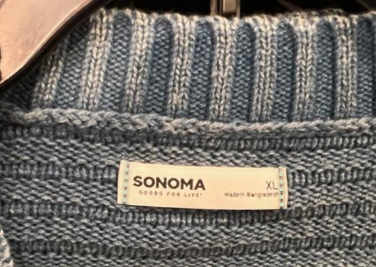
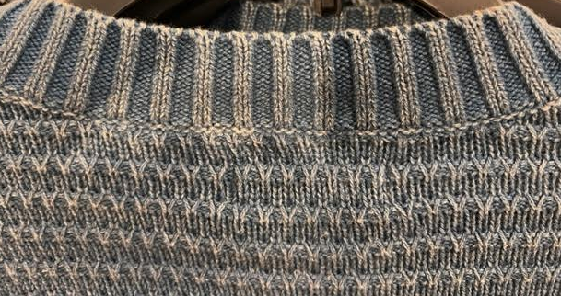
Label Approval
TOP APPLIED LABELS (Endfold, Patch)
- Label should lay smooth/flat
- No wavy edges
- Label set with 1/16” SN/LS - Backstitch @ start & stop for 3-4 stitches
- Label SPI = 8-10
- Thread
- Needle: DTM to Label
- Bobbin: DTM to shell fabric
- No Monofilament/clear thread
- NO Thread nests or untrimmed threads on exterior garment
EXAMPLE
Notes:
http://nordstromsupplier.com/npg/PDFs/Technical%20Design/Label%20Placements/Women's/2014/S6C1%20CE-CEA%20Woven%20Label%20and%20Placement%20Manual.pdf
https://www.colonybrands.com/wp-content/uploads/sites/24/2018/04/NF-11-Label-Placement-Guide.pdf
LE updated image - original image is off to the far right side.
https://www.genescopartners.com/jm/documents/product_category_standards/JM_Womens_Hangtag_Label_Placement_Manual.pdf

